Slide 1
Survey Results
Results of the survey conducted in December 2023

Slide 2
Club Performance
39 Total participants – good participation, but would have liked more
85% scored the club as 5 Stars!
9 people said they would be interested in being a presenter
Overwhelming response on wanting more workshops and hands-on opportunities (100%) and 72% are wiling to help.
Most people want to keep our meeting agenda the same in 2024
Overwhelming support for making CARS the best club in the Atlanta Metro area!

Slide 3
Improvements?
Additional Social Opportunities – Lunch, breakfast and other
Maybe breakout groups at the end of the meeting for people of like interests?
Improved video screen and audio. Will improve presentations and quality
Presenters need to repeat all questions so everyone can hear
After meetings have a “Mentor Table” where people can ask questions
Can ask about anything ham radio-related
Can ask about opportunities for involvement
Have food at meetings? Coffee and maybe donuts and bagels?
Run a licensing workshop for Generals and Extra Class
Help news hams assimilate into the club

Slide 4
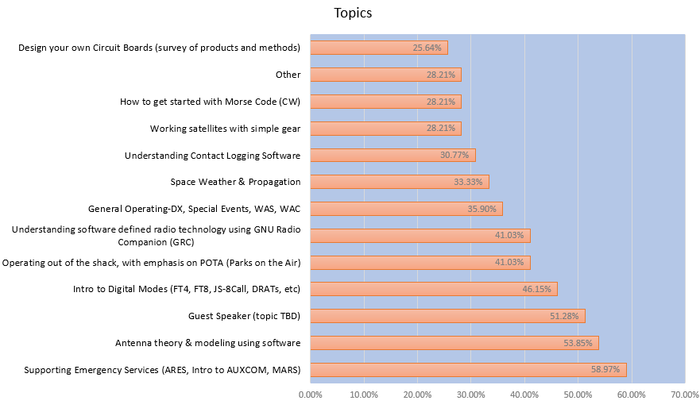
Presentation Topics
Clear winners

Slide 5
“Other” Topics
In-depth discussion about how a repeater works
Mesh Networks and APRS
Digital modes for ARES Support, VARA-HF and VARA-FM
Ham infrastructure. ie. the tower sites, how to acquire a frequency, the repeaters, combiners/duplexers, antenna systems, what it cost to own and operate a HAM repeater
Homebrewing – techniques and opportunities to learn
Go Boxes - Workshop
Getting started with CW (Morse Code)
Practical mobile antennas

Slide 6
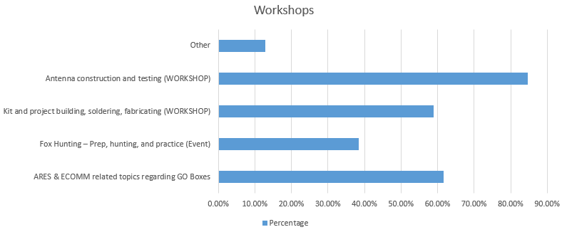
Workshops/ Activity

Slide 7
“Other” Workshops
Navigating component supply chain, building/buying off-grid power solutions
Troubleshooting, using test equipment
Understanding digital
Go Box design, sources, construction
Math for Amateur Radio
Setting up battery and solar power for remote ops

Slide 8
Suggested Projects
Anything with antennas
Soldering, especially kits that do something
Practical satellite communications
Building a HotSpot for DMR & D-Star
Building a loop antenna
Build an Antenna Launcher
Morse Code oscillator/keyer/paddle
Fox Hunting antenna
Wire antenna project –ie EFHW or like
Small projects useful in the shack
PowerPole distribution box
Easy and portable antennas
Build a radio
NanoTNC
Mobile antenna

Slide 9
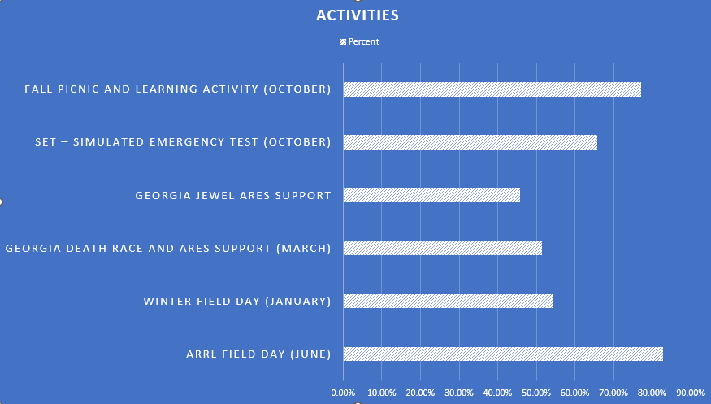
Activity Participation

Slide 10
What activity was best for you?
Field Day! (numbers of these)
POTA picnic event in the Spring at RTM
Soldering workshop
Georgia Death Race
Dr. Fong’s presentation (J-Pole)
Jeff’s presentation on RFI
Space weather and propagation
Understanding Filters
NanoVNA help at FD.
Georgia Jewel – great EMCOMM experience
Antenna workshop

Slide 11
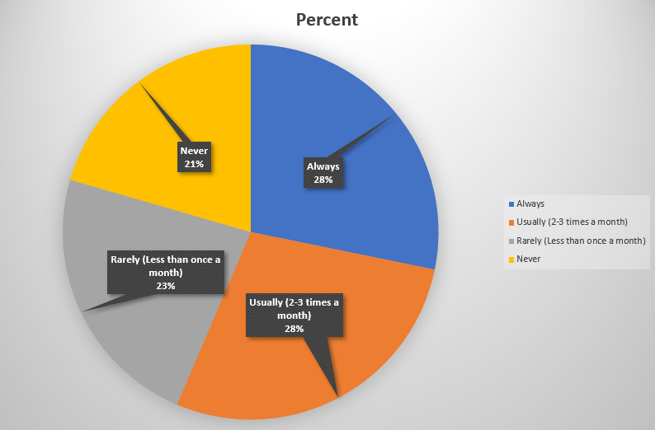
NET participation

Slide 12
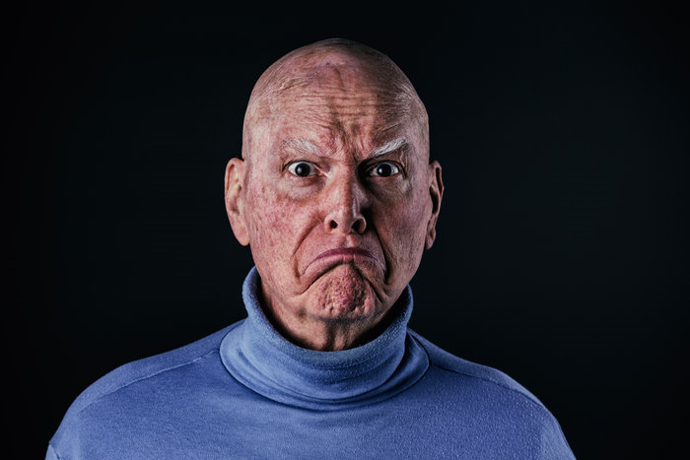
How can we get you to participate?
I’m still learning, I may need help
Can’t attend evening events or have a scheduling conflict, alternate time?
More structure, planned topic?
I don’t know?
Buy me a base station and antenna
I’m happy with it and I participate
Open forum is good. I like that.
Celebrate people with the best attendance?
Have a technical topic to discuss

Slide 13
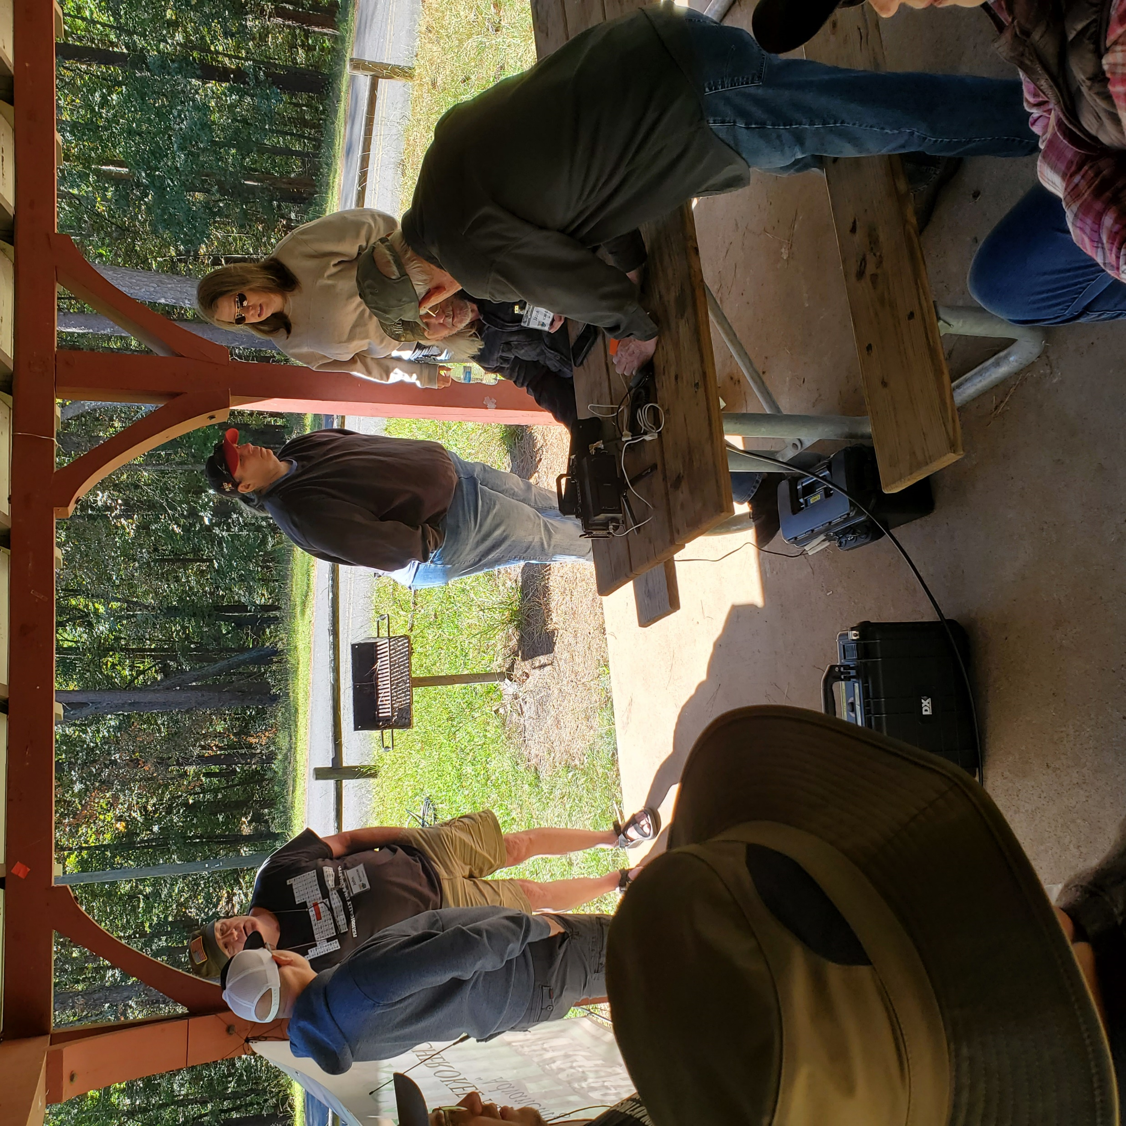
What people liked most about club events
The people , social aspect of the club
Learning new things
People willing to help
GA Death Race was a ton of fun
Nobody feels like an outsider. Everyone is willing to assist with information etc.

Slide 14
What mentoring do you need?
Setting up a home station and antenna
Using 2m and 70cm bands
Learn CW and be able to make some contacts
Help to pass my Amateur Extra test
Understand more about digital modes
Best ways to do grounding for my shack
Getting new members on HF
Working amateur radio satellites
Use HF more effectively

Slide 15
Cherokee Amateur Radio Society 2024
Events
Workshops
Participation
Technical Topics in 2024
Feedback & Questions

Slide 16
Theme for 2024
GET INVOLVED
GET ACTIVE

Slide 17
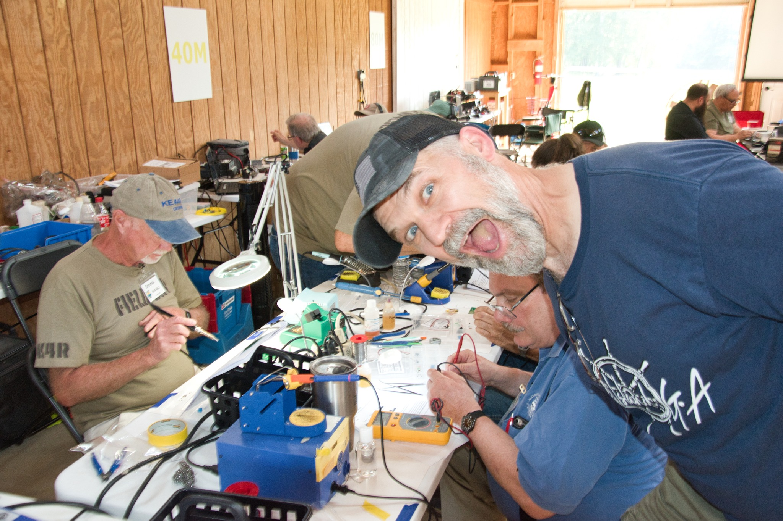
Often overlooked..
One of the biggest benefits and “draws” of a club is the fellowship!
Survey confirmed this many times over
Clubs are failing nationwide because they are not friendly to new people.
CARS needs to be a club that openly welcomes newcomers and new hams.
Be a part of this. We all have the responsibility to create this atmosphere
Continued growth depends on it.

Slide 18
Participation
Reward people for participation? – why? Because it takes a commitment of your time to be involved
We are proposing a point system for participating in selected events
Excluding ARES Events
Points accumulate throughout the year
Prizes given at the December Meeting for your participation ( It’s all in good fun)
We want to recognize people who help this club be vibrant and healthy
Points values and categories to be announced
For members only.

Slide 19
Ways you can be a Participant
Attend the monthly meetings as often as you can
Participate in weekly On-Air Nets ( ARES and Club)
Get involved with the events we host, especially Field Day
Write an article for the newsletter
Prepare a presentation for a club meeting
Participate in a Workshop
Help facilitate a Workshop
Get certified as a VEC and help with testing
Join the team for the Georgia Death Race, Georgia Jewel, and SET
Serve on a Field Day Committee
Assist with setup and takedown at club meetings
Participate in a SIG (POTA, Homebrew, etc)
Mentor New Hams (Mentor Desk and individually)

Slide 20
Major Events Calendar for 2024
Event | When | Where
Winter Field Day | January 27-28 | Red Top Mountain State Park
Spring Picnic & Learning Event | April (TBD) | TBD
ARRL Field Day 2024 | June 22-23 | TBD, but likely at the barn in Taylorsville
Fall Picnic and POTA Event | October (TBD) | Red Top Mountain State Park
CARS Holiday Party | December 14, 2024 | WG Long Center

Slide 21
Workshops
Tape Measure Yagi antenna build (repeated event since we have new hams)
Sign-up sheet available
Dates yet TBD
Antenna Theory and Modelling – dates TBD – after meeting event
Soldering Project – Field Day 2024 , June 22 – (Project being defined)
Advanced Builders project – (WSPR transmitter, or other complex build)
Optionally- General and or Extra Class Tutoring Sessions

Slide 22
Technical Presentations
Meeting Date | Topic | Presenter(s)
January 13 | 2024 Clubs Plans | Leaders Team
February 10 | Supporting Emergency Services | Rob Bruderer
March 9 | ARISS and Working Satellites | Daryl Young
April 13 | Extreme POTA – Lessons Learned | Chad Cone, Jason Turnage
May 11 | Understanding WSPR and WSJT-x | Marty Buehring
June 8 | FIELD DAY WORKSHOP & PREP | Chad Cone & FD Committee
July 13 | Guest Speaker (TBD) | TBD
august 10 | Digital Modes (FT*,JS8CALL, VARA, APRS) | TBD
September 14 | All About DMR ( could be substituted) | TBD
october 12 | Operating outside the Shack | Jason Turnage
november 9 | GNU Radio | Maybe Marty or Guest
december 14 | Holiday Party | NONE
Subject to change based on speakers availability

Slide 23
FEEDBACK AND QUESTIONS

