Slide 1
2018 Review & Future of Ham Radio
Martin Buehring – KB4MG - CARS President
October 13, 2018

Slide 2
CARS Mission Statement
The mission of the Cherokee Amateur Radio Society is to promote the hobby of amateur radio to the Cherokee County residents and surrounding communities. It primarily serves to provide education, FCC testing, public service, and fellowship to people with the common interest of amateur radio.

Slide 3
Major Club Activities
Activity | Time
Monthly Meetings | Second Saturday of every month
Weekly 2m Nets | Each week at 8:00PM on 145.270 MHz FM
Technical Programs & Presentations | Each monthly meeting, topics vary
FCC License Testing | Each month at 2PM at club meeting location
Ham Cram(s) | Periodically, one scheduled for Feb, 2019
Georgia Death Race – Public Service | As Needed
ARRL Field Day 2018 | June 23-24, 2018 , June 22-23, 2019
Boy Scouts of America - JOTA | October 19-21, 2018
Elmers (ie Mentors for help new Hams) | As needed, volunteers needed
Repeater maintenance | As needed, volunteers needed
Project Building | As needed. Offered to those DIY minded hams
WWW and Internet Presence | Committee

Slide 4
Focus on Education thru Shared Knowledge Four Major Areas
Operators
Contesting
Focus on achievements like WAS, WAC, etc
Exploring other modes – CW, RTTY, Digital – FSK PSK, JT-65, JT-9, etc
QRP operating – often outdoors
SOTA or similar outdoors operating
Field Day
DMR and Hotspots
EMCOMM
ARES
Public Service
Go Boxes , design and construction
Repeaters
Builders & Experimenters
Building your own equipment
Electronics experimentation
Antenna design and construction
Many more possibilities with kits and DIY
Extending the hobby
APRS
Direction finding
Maker fairs
STEM program volunteer work
Drones

Slide 5
Where is Ham Radio going today?
Activity | Trend
Hamfests | ⬇
Field Day | ➔
Testing | ➔
DIY/Homebrewing | ⬆
Elmering | ⬇
School Involvement | ⬆
ARES/EMCOMM | ⬆
Preppers | ⬆
SOTA/ Portable | ⬆
Drones & other RC | ⬆
Operating | Trend
Repeaters | ⬇
Rag Chewing | ⬇
Contesting | ⬆
Digital Modes | ⬆⬆
Satellite | ⬆
HF Bands | ⬇
VHF/UHF Bands | ➔
Microwave | ?
Modes | Trend
Phone – SSB & AM | 
CW | 
PSK | 
Packet | ⬇
FT8 | ⬆⬆
DMR | ⬆⬆
D-STAR | ➔
EchoLink | ⬇
FT8-CALL | ⬆

Slide 6
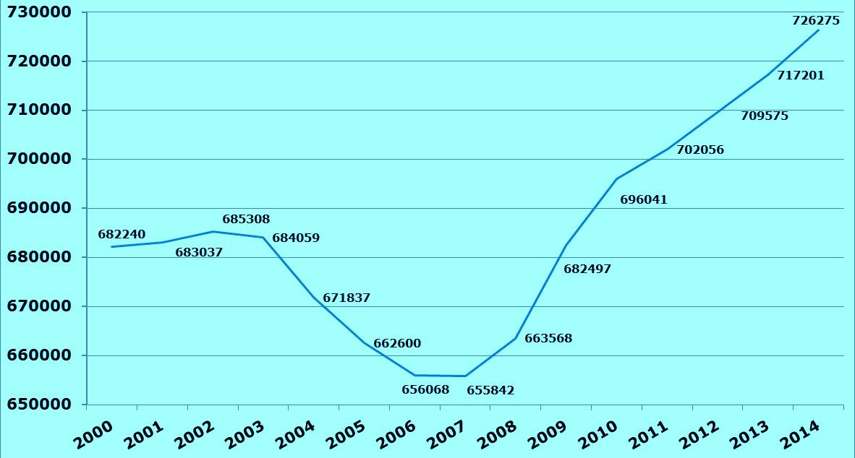
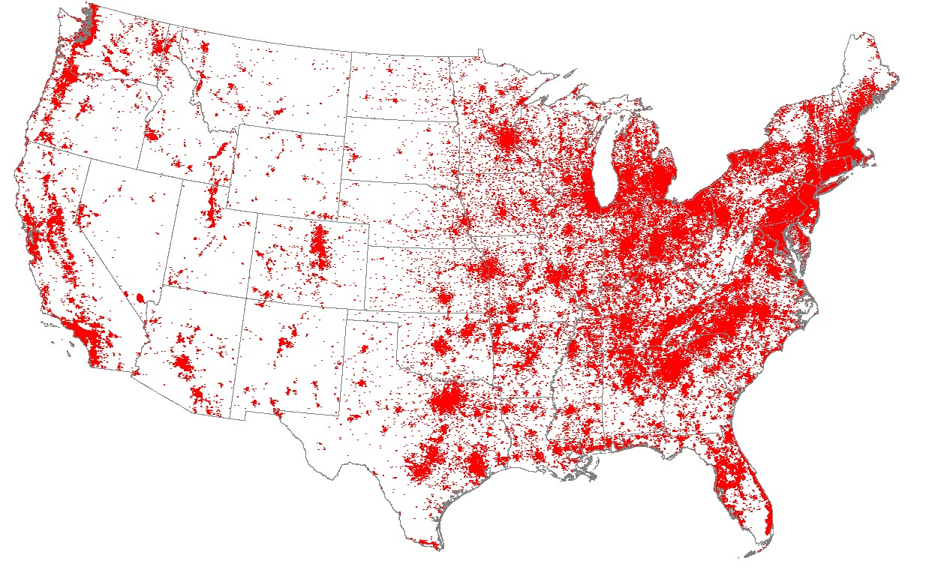
Numbers of Hams in the US and Territories
Distribution of Licenses
Solar max
Cycle 23
Morse Code
Requirement
dropped
Financial
Crisis
Solar max
Cycle 24
Latest number is 753,394 (September 2018)

Slide 7
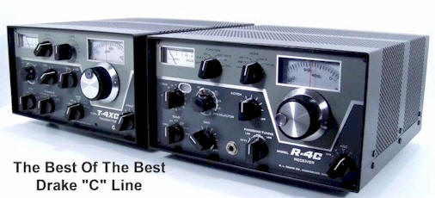
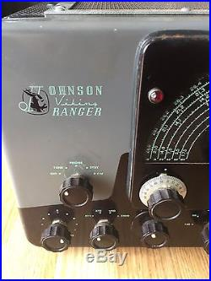
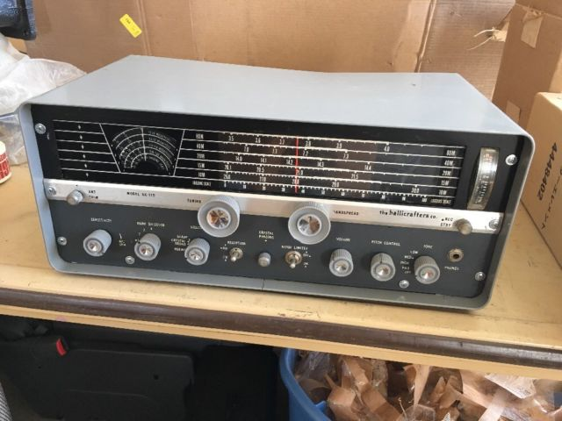
Where have we been?
CW and Phone (mostly SSB) dominated the airwaves.
CW was still required up to 2003 FCC change eliminated it.
Lots of hams built home-brew equipment
Companies like Heathkit, Knight, and a few others offered kits for decent radios
If you had money you would buy Collins, Drake, Viking, Hallicrafters, and military surplus

Slide 8
HS and College Radio Clubs were common
Station WA9DNX Chicago, IL
Circa 1967

Slide 9
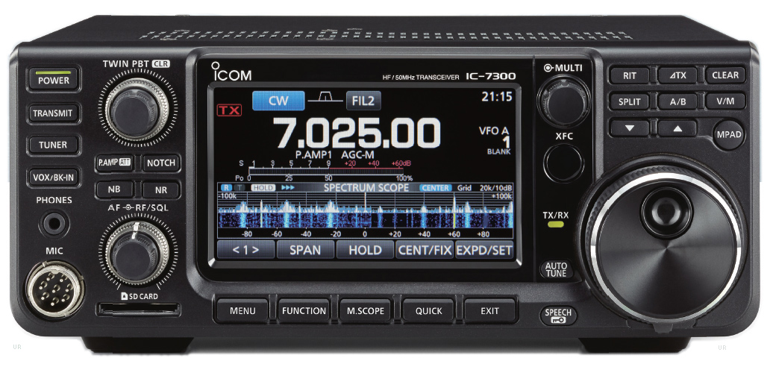
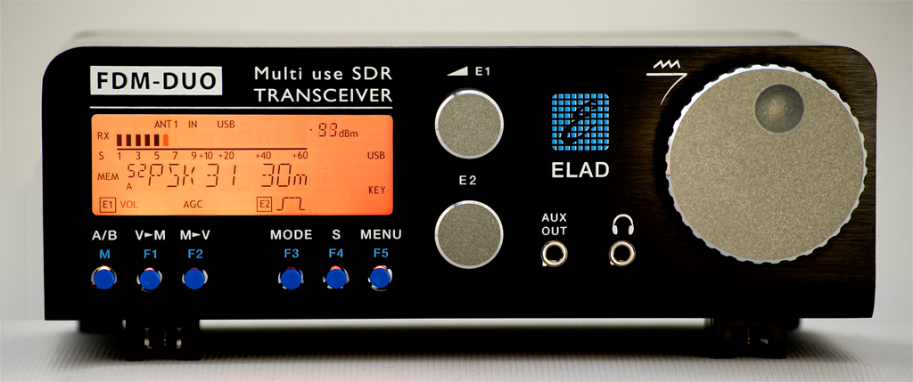
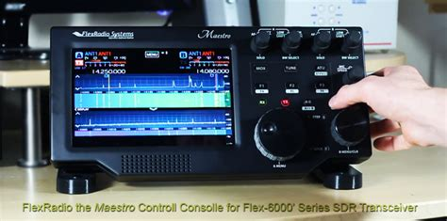
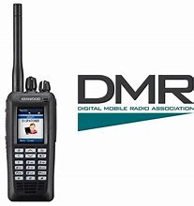
Where are we now?
Radio technology grew rapidly and leveraged designs from the commercial world
With microelectronics and computers made radios very capable and complex.
SDR became a new way to build radios with lots of bandwidth. [Flex, ICOM, many others now]
Digital modes are gaining ground really fast.

Slide 10
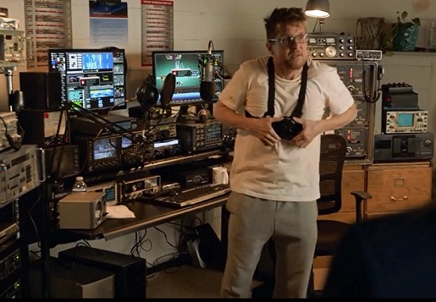
What’s controversial?
Has the Ham Radio landscape changed? If so how and why?
Many older hams don’t like the digital modes, especially FT8 and on-conversational modes. Claim that this is not what amateur radio is about.
If the Internet is “involved” in the communication channel, then is it amateur radio?
Has the solar minimum reduced interest in our hobby?
Have Ham Radio Podcasts help create more interest?
Has the “media” misrepresented us?
NCIS episode, Season 15, Episode 6

Slide 11
What can CARS do better or different?
Activities?
Reaching out to youth? – STEM, HS clubs, after school electronics ,etc?
Scouts programs – offering to help local troops?

Slide 12
Participation is Everything
Thanks for all the support and participation we had in 2018
Looking forward to an even greater 2019!

